Slide 1


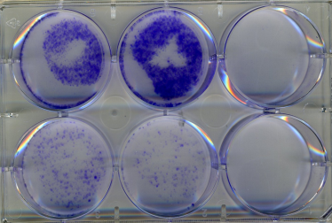
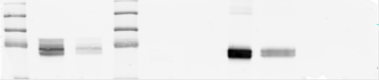
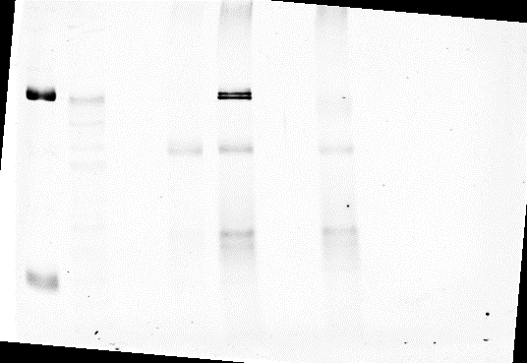
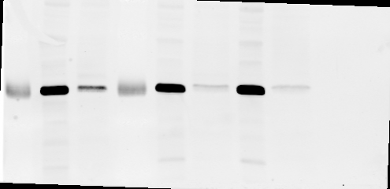

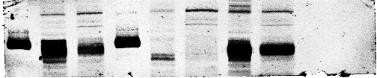
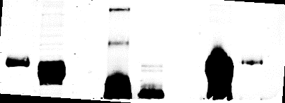
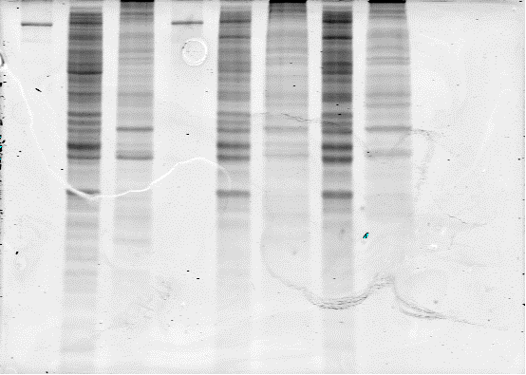
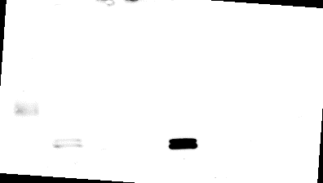
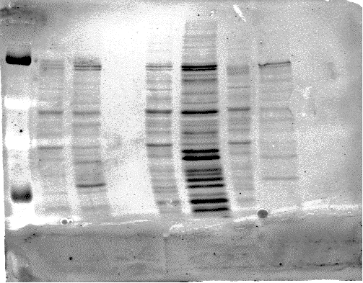
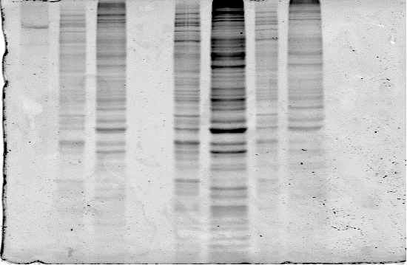

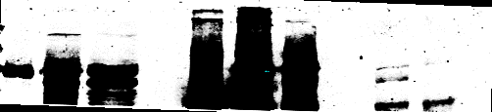
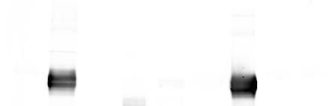
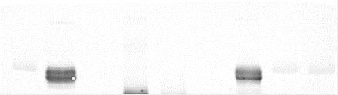
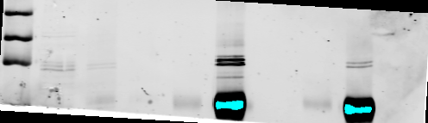
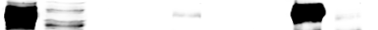
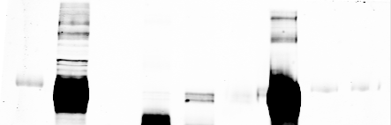
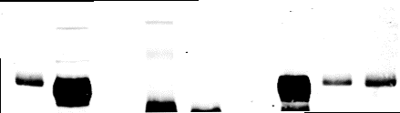
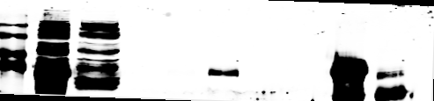
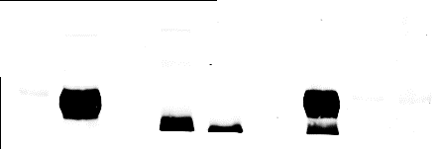
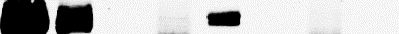
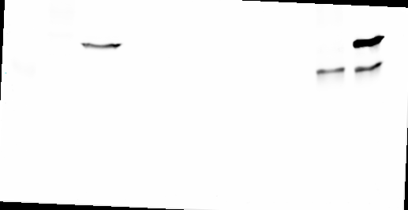
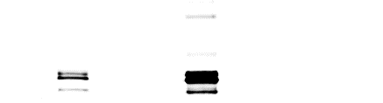
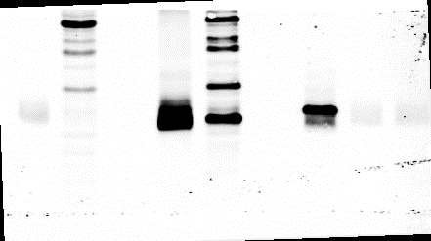
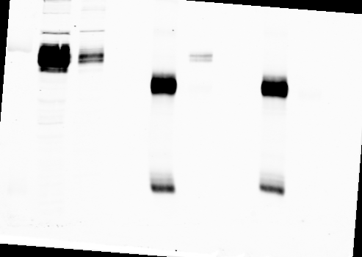
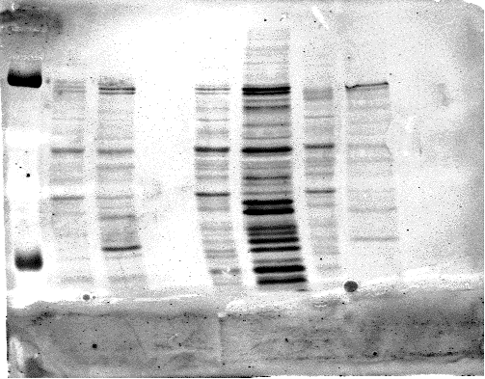
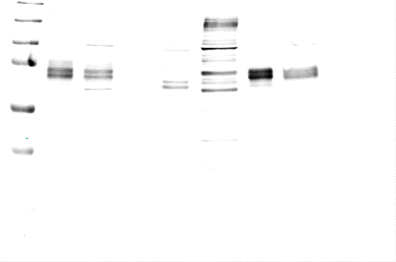


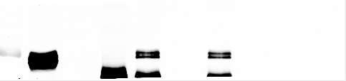
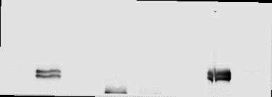
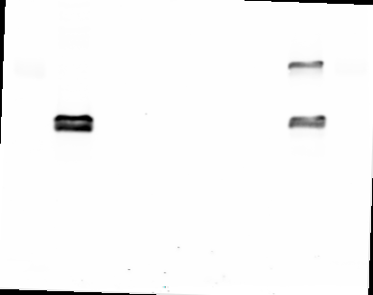
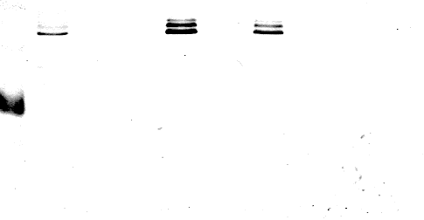
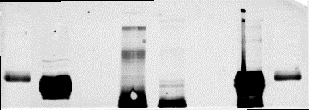
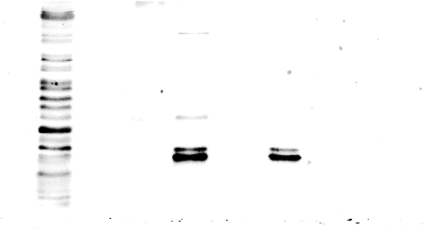
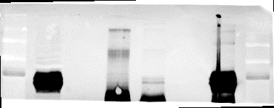
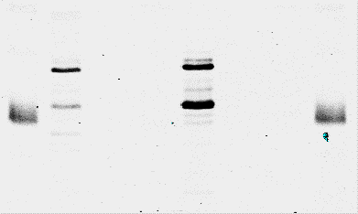
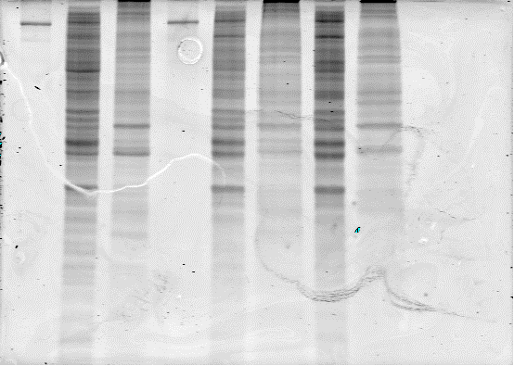
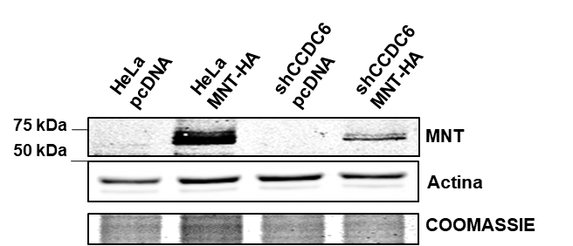
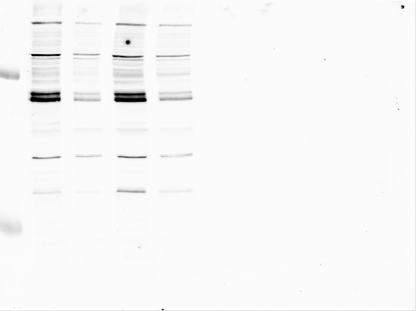
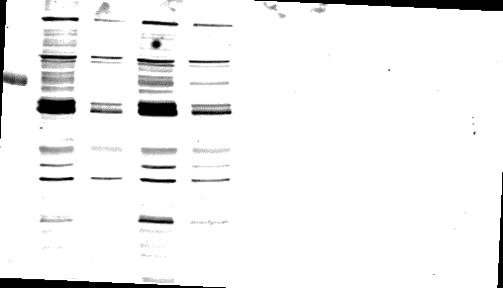
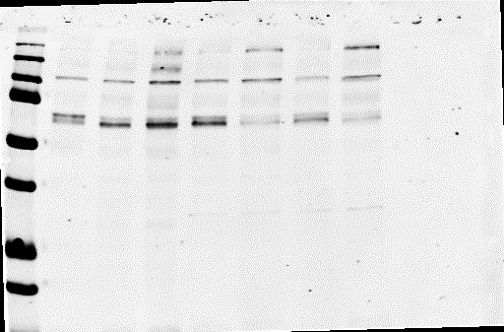
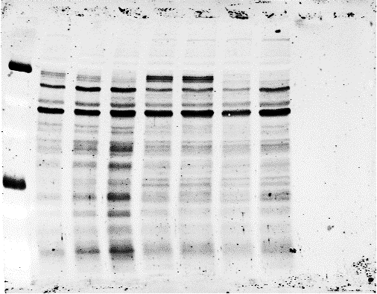
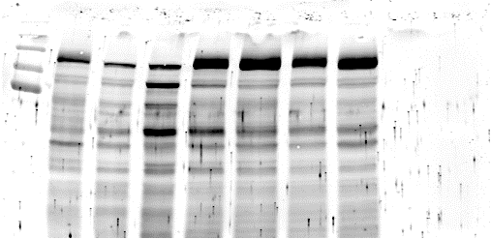
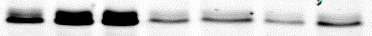
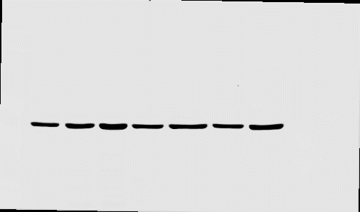
Physical and functional interaction between MNT and CCDC6
Sandra Lastra
supervisors: Javier León and M. Dolores Delgado
Instituto de Biomedicina y Biotecnología de Cantabria (IBBTEC), Santander, Spain.
INTRODUCTION
MNT, is member of MXD family from the MYC-MAX-MXD network. It is localized in the 17p13.3 human chromosome that is a region of genomic instability, so its function may be altered and consequently be involved in some diseases. This chromosome loss is observed in many adenocarcinomas. MNT is considered an essential protein due to its several roles in the cell. It is a ubiquitously expressed protein which does not fluctuate during cell cycle. MNT-MAX heterodimers are found in proliferating cells that contain MYC-MAX heterodimers, which suggests a possible important role of MNT during proliferation. MNT expression lost led to adenocarcinomas due to their accelerated entry in the cell cycle, leading to a faster proliferation and avoiding senescence.
Our preliminary results from proteomic screenings showed that MNT interacts with CCDC6.
CCDC6 gene product is a 65 kDa nuclear and cytosolic pro-apoptotic phosphoprotein. Its amino acid sequence contains a long coiled-coil region that allows protein-protein interaction and a putative SH-3 binding domain. Under DNA damage conditions CCDC6 suffers ATM-mediated phosphorylation making it more nuclear and leading to apoptosis. In ATM deficient cells, this phosphorylation does not occur correctly, and the endogenous CCDC6 is localized in the cytoplasm and excluded from the nucleus and cells do not suffer genotoxic stress- induced apoptosis. CCDC6 was first isolated fused to the protooncogene RET, generating the RET/papillary thyroid carcinoma (PTC) oncogene. CCDC6 provide the first 101 amino acids necessary for the activation of PTC1. CCDC6 depletion or mutation contributes to the oncogenic activity by increasing growth rates of the affected cells, reducing apoptosis and affecting DNA damage repair. CCDC6 is also able to interact directly with proteins and transcription factors such as CREB1 that regulates the transcription of proteins involved in cell proliferation. CCDC6 is also described as a negative regulator of serine-threonine protein phosphatase 4 (PP4c) that dephosphorylates H2AX avoiding the DNA repairing process (2).
RET/PTC (PTC1)
N-
101aa
CCDC6
N-
101aa
Coiled coil
474aa
537aa
65kDa
HYPOTHESIS AND AIMS
Hypothesis: CCDC6 and MNT form complexes in the nucleus or the cytoplasm and these complexes can regulate relevant cellular processes such as cell proliferation or DNA damage response.
The aims of this project were:
Confirm MNT-CCDC6 interaction and delimitate the interaction domains.
Study the nuclear or cytoplasmatic localization of the CCDC6-MNT complex .
Evaluate the effects of CCDC6-MNT on cell proliferation, DNA damage and apoptosis.
RET
-C
SH3
-C
1) Cell lines
  293T is a cell line from epithelial of embrionic kidney.
  HeLa is a cell line from epithelial of cervical carcinoma
  HAP1 is a cell line from bone marrow. It comes from a chronic myeloid leukemia (CML) patient.
MATERIALS AND METHODS
8) Immunoprecipitation assays
To study protein-protein interactions.
Cells were lysed and incubated with Gammabind Sepharose Beads Capture immuno-complexes and an antibody
Western blot were performed
4) Clonogenic assays
  HeLa and HeLa shCCDC6 cells were transfected with pcDNA and MNT-HA (which confer resistance to zeocine) and with pCEFL (that confer G418 resistance).
  Cells were selected with the antibiotics and after 10 days proliferation was measured
2) Transient transfection
Transient transfections were performed with PEI that is able to condensate DNA into positively charged particles that go inside the cell by endocytosis
pcDNA
MNT-HA
pCEFL
Transfection
HeLa
6) SDS-PAGE and Western Blot
To analyse protein levels
Cells were lysed, sonicated and quantified
Proteins were separated according to their molecular weight in a polyacrilamide SDS gel.
Proteins were transferred to a nitrocellulose membrane, incubated with antibodies and scanned
HeLa-shCCDC6
3) Production of Lentiviral Particles
HEK293T cell were used for lentivirus production.
Lentiviral particles containing a short hairpin sequence for CCDC6 in order to silence CCDC6 in HAP1 cells.
5) Viability analysis upon drug treatment
HAP1 and HAP1 MNT KO were exposed to etoposide and cisplatin drugs .
After 2 days, viable cells were measured with WST-1
pCMV-VSV-G
psPAX2
shCCDC6
Transfection
Infection
HAP1
Cisplatin
Etoposide
DNA damage
HAP1
5) Nuclear-cytoplasmic fractionation
Soft lysis: Lyses buffer 1 was added to HeLa cells to break cytoplasm and NP40 lysis to break the nucleus.
Protein concentration was measured and IP was performed
HEK293T
Lentivirus
Infection
HAP1-MNT KO
DNA damage
HAP1-MNT KO
RESULTS AND DISCUSSION
  1) MNT and CCDC6 interaction
  2) MNT and CCDC6 subcellular localization
A)
SID
b
HLH
LZ
CoIP
C)
MNT-HA wt
SID
b
HLH
LZ
HA
A)
WB
HeLa pcDNA Cyto
HeLa pcDNA nucl
HeLa CCDC6 Cyto
HeLa CCDC6 nucl
Human
MNT wt
1
582
1
293T MNT wt HA + CCDC6-myc WT
591
600
IP
HA
CCDC6-MYC
CCDC6 wt
Coiled coil
SH3
MT
YES
Input
IgG
α-HA
HA
65 kDa
CCDC6 1-223
1
Coiled coil
MT
474
MT=Myc-tag
NO
75 kDa
MNT
MNT
37 kDa
Rho Gdi
CCDC6 1-101
1
MT
223
NO
65 kDa
CCDC6
CCDC6
MT
130 kDa
Sin 3B
1
101
65 kDa
CCDC6 more contrasted
COOMASSIE
D)
25 kDa
LZ
MAX
HA
MNT-HA ΔNt1
HA
75 kDa
MNT
293T transfected with MNT + CCDC6-myc wt
293T transfected with MNT + CCDC6-myc 1-223
MNT-HA ΔNt2
273
301
591
600
COOMASSIE
B)
IP
Inputs
α -MNT
α -MYC
MNT
and
MNT
CCDC6-wt
293T MNT ∆NT2 HA + CCDC6-myc wt
301
591
600
293T MNT ∆NT1 HA + CCDC6-myc wt
HA
MNT-ΔNt2
Anti-MNT Cyto
75 kDa
WT
1-223
IgG
wt
1-223
wt
1-223
MNT
CCDC6-wt
MT
MT
IP
Input
IgG
α -HA
IP
INPUT
IgG
α-HA
CCDC6
MT
B)
IP
Input cyto
Input nucl
IgG Cyto
IgG nucl
Anti-MNT nucl
65 kDa
MNT more contrasted
65 kDa
CCDC6
65 kDa
CCDC6
75 kDa
MNT
CCDC6
MNT
65 kDa
CCDC6 more contrasted
65 kDa
CCDC6 more contrasted
37 kDa
CCDC6 more contrasted
MNT
37 kDa
37 kDa
MYC
65 kDa
CCDC6
MYC
and
CCDC6 1-223
MT
E)
HA
HA
HA
MNT-ΔNt1
CCDC6
MT
65 kDa
CCDC6
IP
293T MNT transfected with + CCDC6-myc 1-101
CCDC6 1-223
MT
ΔCt 1 MNT-HA
SID
b
HLH
LZ
HA
ΔCt 2 MNT-HA
HA
75 kDa
MNT
Input
IgG
α -MNT
α -MYC
1
315 324
1---19
202 211
65 kDa
CCDC6
75 kDa
1-101
1-101
MNT
MNT
IP
293T MNT ∆CT1 HA + CCDC6-myc wt
IP
293T MNT ∆CT2 HA + CCDC6-myc wt
HA
COOMASSIE
65 kDa
CCDC6
MNT
and
65 kDa
Input
IgG
α-HA
CCDC6
65 kDa
Input
IgG
α -HA
CCDC6
MNT-ΔCt1
CCDC6
MT
65 kDa
CCDC6-MYC
20 kDa
MYC
CCDC6 1-101
MT
CCDC6 1-101
MT
50 kDa
HA
65 kDa
CCDC6 more contrasted
37 kDa
Rho Gdi (cytoplasm marker)
37 kDa
65 kDa
MYC
20 kDa
MAX
25 kDa
HA
HA
MNT-ΔCt2
CCDC6
130 kDa
Sin 3B (nucleus marker)
Scheme of the transfected MNT wt and CCDC6 wt and CCDC6 mutants.
MNT and CCDC6 wt interact but MNT and 1-223 CCDC6 mutant do not interact. 1-101 CCDC6 mutant do not interact with MNT wt.
C) Mouse MNT wt and CCDC6 wt interaction.
D) ΔNt2 interact with CCDC6 but ΔNt1 does not interact with it.
E) ΔCt1 and ΔCt2 MNT mutants interact with CCDC6.
MT
COOMASSIE
A) WB in order to confirm CCDC6 and MNT overexpression, also the fractionation of cytoplasm and nucleus (markers: Rho GDI and Sin 3B, respectively)
B) CCDC6 and MNT interaction occurs mainly in the cytoplasm
  3) Effects of CCDC6 and MNT on cell proliferation
4) Effects of MNT and CCDC6 on DNA damage
5) Effects of CCDC6 silencing on apoptosis
A)
A)
Hap 1 control shCCDC6
Hap 1 MNT-ko shcr
A)
B)
65 kDa
Hap 1 control shcr
Hap 1 MNT-ko shCCDC6
CCDC6
50 kDa
Actin
Hap 1 MNT-ko shCCDC6
B)
B)
65 kDa
K562
Control -
Control +
Hap 1 control shcr
Hap 1 control shCCDC6
Hap 1 MNT-ko shcr
CCDC6
Cells were incubated with etoposide and cisplatin:
Cisplatin does not seem to affect the cells survival.
MNT-KO cells survival are more affected by etoposide than HAP1 control cells. MNT seems to confer the cells resistance to etoposide.
.
75 kDa
MNT
89 kDa
PARP
30 kDa
BCL-XL
WB to confirm the overexpression of MNT in HeLa an HeLa shCCDC6 cells.
Clonogenic assays after selection with G418 or zeocin
Proliferation inhibition is observed although results are not statistically significant
50 kDa
Actin
Silencing of CCDC6 by lentiviral infection in HAP1 and HAP1-MNT-KO cells is confirmed by a WB assay.
WB in order to study the role of CCDC6 and MNT in apoptosis. There is no cleavage of PARP. We can observe an increase in the level of BCL-XL in HAP1 MNT-KO shCCDC6 cells, suggesting a role in apoptosis.
CONCLUSIONS
MNT-CCDC6 interaction is confirmed. The C-terminal domain of CCDC6 seems to be required.
The C-terminal of MNT protein plus the leucin zipper domain and the N-terminal of the MNT protein seem to be required for CCDC6 interaction. MNT-CCDC6 interaction seems to occur mainly in the cytoplasm.
The silencing of CCDC6 plus the overexpression of MNT does not affect significantly the proliferation of HeLa cells.
HAP1 MNT KO cells are more sensitive to etoposide than HAP1 control.
There is an increase of the anti-apoptotic BCL-XL protein levels upon CCDC6 and MNT knockdown, suggesting an effect of these proteins on apoptosis.
FUTURE WORK
Elucidate the exact interaction domains in MNT-CCDC6 complexes
Confirm the effects of silencing of CCDC6 and overexpressing MNT in proliferation
Clarify the obtained results in HAP1 and HAP1-KO cell line after their exposure to cisplatin and etoposide
Determine the role of CCDC6 in HAP1 cellular model performing new experiments with shCCDC6 lentiviral constructs
REFERENCES
Yang G, Hurlin PJ. MNT and Emerging Concepts of MNT-MYC Antagonism. Genes. 2017;8(2)
Cerrato A, Merolla F, Morra F, Celetti A. CCDC6: the identity of a protein known to be partner in fusion. International journal of cancer. 2018;142(7):1300-8
ACKNOWLEDGEMENTS
I would like to thank Dolores Delgado, Javier León, Judit Liaño and their group for help, support, trust and especially for their patience during my master’s project.

